Slide 1

Red-Black Coins
Mehdi Salehi
Jeremy Clark
Mohammad Mannan
DeFi’21, March 5, Virtual

Slide 2
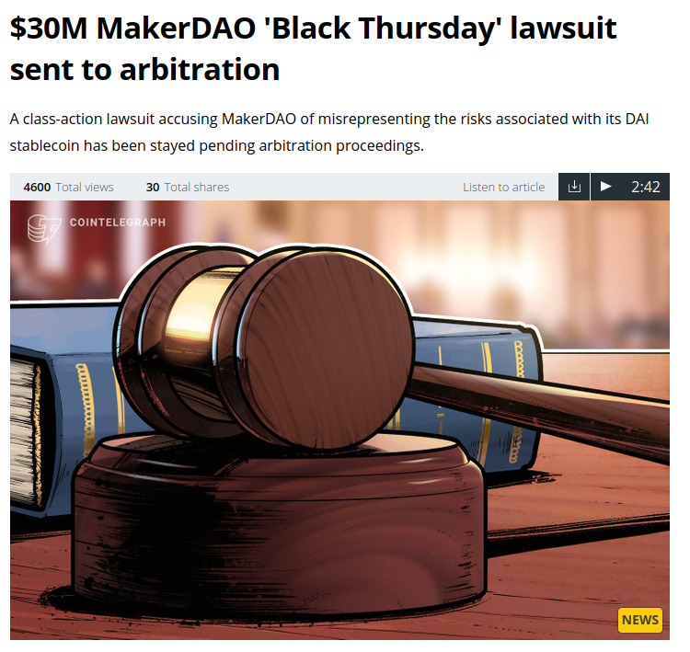
Motivation
Risk assessment of Dai
Idea of Red-Black coins:
Simple non-custodial stable coin
Analyze the core Idea
Alternative design choices
Notes:
Assertion: you cannot eliminate the inherent risk in something like Dai. If ETH goes to zero, all fancy FALLBACK mechanisms (liquidations, debt auctions, global shutdown, etc) will fail and holders will get burned. You can push risk around. We know this from traditional finance. And the problem with it is it gets complex and obfuscated. People don’t truly understand the risks. And they get unexpectedly burned in rare events.
The idea of Red-Black coins is to make the simplest possible (non-custodial) stablecoin and study it
It is so simple that it lacks some basic features -> brainstorm alternatives to achieve these features (What projects like Dai do is not the only way)

Slide 3





Real world projects
Fiat currencies
US dollar
Euro
Other assets (e.g. stock share, commodities)
UMA

Slide 4


Core Idea
Pick an Underlying asset
Deposit on Dapp
Notes:
Underlying asset - LIKE ETH

Slide 5

Core Idea
Notes:
Split ETH in parts

Slide 6


Core Idea
Black Coin (Peg)
Red Coin (Risk Absorber)
Notes:
Black / Peg / Dai / Synthetic
Red / Risk Absorber / CDP / Vault

Slide 7
Core Idea
Black Coin (Peg)
Other Mechanisms
(e.g Liquidation)
Red Coin (Risk Absorber)
Notes:
Liquidations, fees, withholding rewards, global shutdown, debt auctions

Slide 8
Core Idea
Black Coin (Peg)
Other Mechanisms
(e.g Liquidation)
Red Coin (Risk Absorber)
Notes:
WHY? There is no good study of the core mechanism. Most related work deal with liquidations. Liquidations add a lot of complexity, we want a firm grasp on the core mechanism before introducing these enhancements. Also, do we NEED liquidations? What if there is something else?

Slide 9
Core Idea: Dai without liquidations
No study on core mechanism
Liquidation adds complexity
Do we need liquidations?
Notes:
WHY? There is no good study of the core mechanism. Most related work deal with liquidations. Liquidations add a lot of complexity, we want a firm grasp on the core mechanism before introducing these enhancements. Also, do we NEED liquidations? What if there is something else?

Slide 10

Financial Characteristics (Stable Coin)
Black Coin (Pegging a dollar)
$1
Red Coin (Risk Absorber)
$0.5
$1.5

Slide 11

Financial Characteristics (Stable Coin)
Black Coin (Pegging a dollar)
$1
Future?!
Red Coin (Risk Absorber)
$0.5
$1.5
Notes:
Future if there are no liquidations

Slide 12
Pricing
No liquidations
Perfect liquidity (supply & demand)
$(Deposited ETH) = $(Black Coin) + $(Red Coin)

Slide 13
Characteristics
 | ETH goes down a lot | ETH down a little | ETH Same | ETH Up a Bit | ETH up a lot
Black Coin |  |  | $1
Red Coin |  |  | $0.5
Notes:
OK now lets think about different scenarios of the future
If the eth price stays the same

Slide 14
Characteristics
 | ETH goes down a lot | ETH down a little | ETH Same | ETH Up a Bit | ETH up a lot
Black Coin |  |  | $1 | $1 |  | Sable
Red Coin |  |  | $0.5 | Goes up more

Slide 15
Characteristics
 | ETH goes down a lot | ETH down a little | ETH Same | ETH Up a Bit | ETH up a lot
Black Coin |  |  | $1 | $1 | $1 | Sable
Red Coin |  |  | $0.5 | Goes up more | Goes up a lot | Leveraged

Slide 16
Characteristics
 | ETH goes down a lot | ETH down a little | ETH Same | ETH Up a Bit | ETH up a lot
Black Coin |  | $1 | $1 | $1 | $1 | Sable
Red Coin |  | Goes down a lot | $0.5 | Goes up a lot | Goes up a lot a lot | Leveraged
Notes:
Lets think about the other way. If the price falls a bit

Slide 17
Characteristics
 | ETH goes down a lot | ETH down a little | ETH Same | ETH Up a Bit | ETH up a lot
Black Coin | <$1 | $1 | $1 | $1 | $1 | Sable
Red Coin | Goes to zero | Goes down a lot | $0.5 | Goes up a lot | Goes up a lot a lot | Leveraged

Slide 18
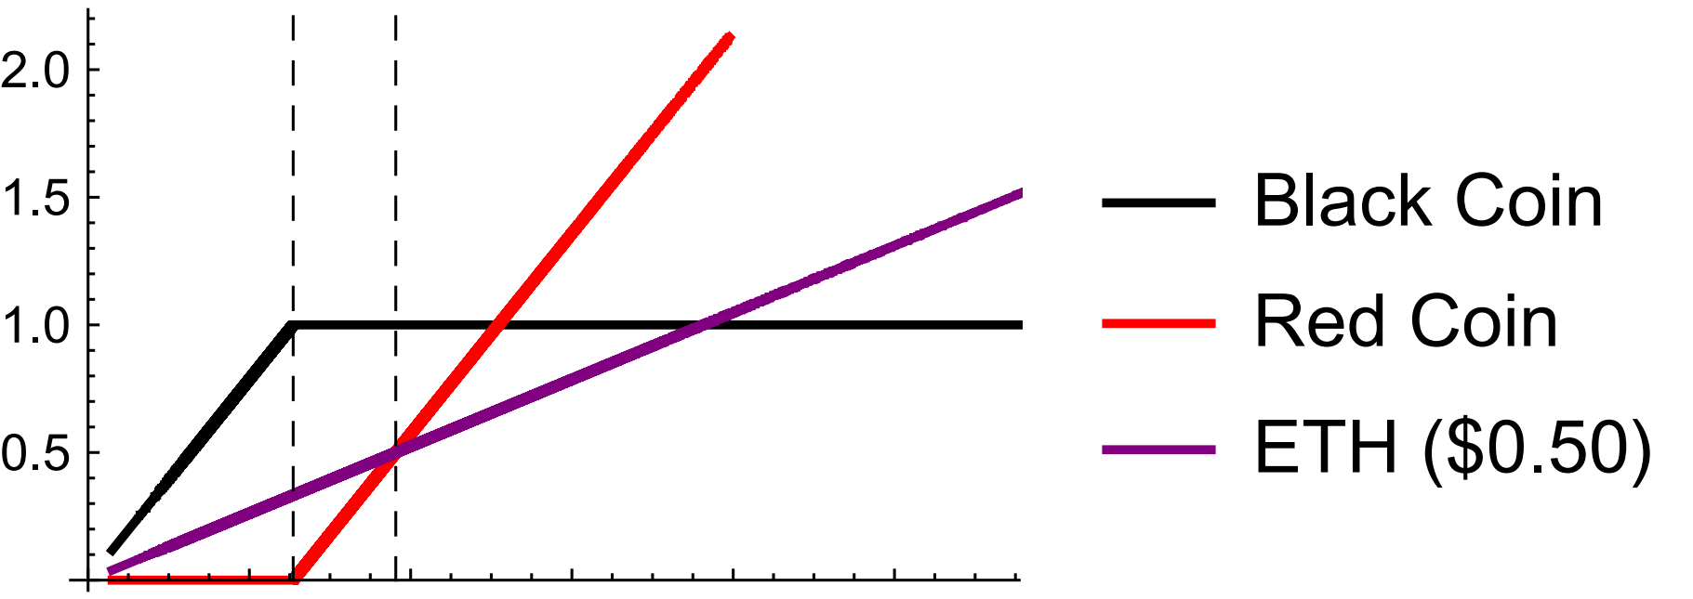
Financial Analysis
Starting Point
A red coin, a black coin, and ETH equivalent to $0.50.
Notes:
Label axis. Second dotted line is starting point. First dotted line - breaks the buck.
NEW SLIDE: Imagine you hold a black coin. It can redeemed one year from now. How much is it worth? (Clearly not a dollar, but probably pretty close - what does that mean? 0.90? 0.99? 0.60?). Do this if we can model ETH/USD. We can!

Slide 19
Financial Analysis
Starting Point
Breaking the Buck
Notes:
Label axis. Second dotted line is starting point. First dotted line - breaks the buck.
NEW SLIDE: Imagine you hold a black coin. It can redeemed one year from now. How much is it worth? (Clearly not a dollar, but probably pretty close - what does that mean? 0.90? 0.99? 0.60?). Do this if we can model ETH/USD. We can!

Slide 20

Financial Analysis
Black Coin price in 1 year:
$1 ?!
$0.99?!
$0.60?!
Need a model for ETH/USD
Notes:
The question here is If we have a black coin. What will be the price in one year?
NEW SLIDE: Imagine you hold a black coin. It can redeemed one year from now. How much is it worth? (Clearly not a dollar, but probably pretty close - what does that mean? 0.90? 0.99? 0.60?). Do this if we can model ETH/USD. We can!

Slide 21
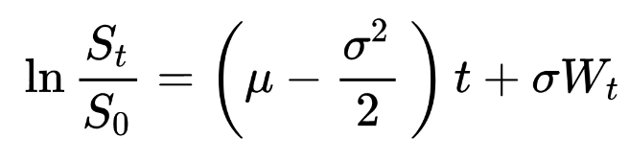
Financial Analysis Model
Geometric Brownian Motion (GBM)
Model Stock Prices in Black-Scholes
Monte-Carlo simulation
Probability of Different outcomes

Slide 22
Financial Analysis Model
Closing’ prices for 1000 days prior to 18 Sept 2020
µ = 0:000744754
σ = 0:0524172
100 days using Monte Carlo
10,000 samples
Notes:
We aren’t first paper to do this,

Slide 23
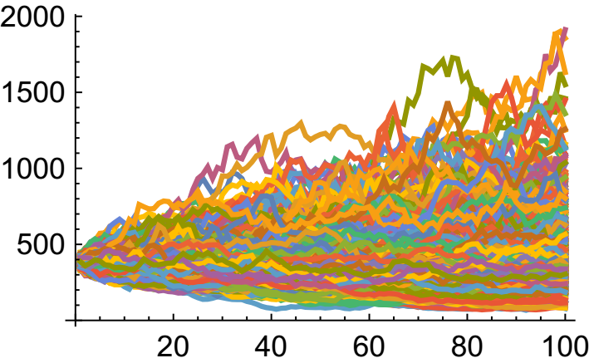
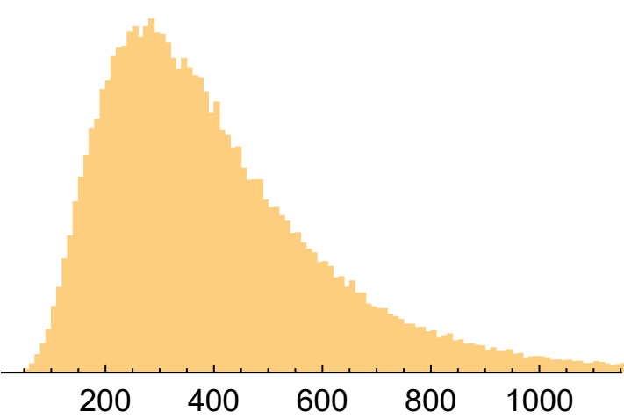
Financial Analysis
Price of ETH in USD (y-axis) over number of days (x-axis)
Histogram of final price of ETH in USD (x-axis)
Notes:
ONLY ETH, nothing to do with Red/blaack coins just yet

Slide 24
Black Coin Analysis
Period | 100 days | 200 days | 1 year
Average Value | $0.94 | $0.85 | $0.80
Notes:
FIXED TERM Expiration

Slide 25
Black Coin Analysis
Collateral Factor
Ratio between Deposit and Target price
$1.5 → 1.5
Collateral Factor | 1.5 | 1.1 | 2
Average Value | $0.94 | $0.86 | $0.98
Notes:
This type of analysis allows us to isolate and study other parameters.

Slide 26
Extending RB Coins
Fungibility
Redemption
Under-collateralization
Supply/Demand
Notes:
Add back the kinds of things Dai has, but without doing exactly what Dai does necessarily. Instead of thinking about WHAT Dai does, we think about WHY they do it. Brainstorm alternatives. Maybe they are better, maybe not, Dai is significantly complicated … too complicated to be sure they got everything right

Slide 27
Fungibility
Forgo fungibility
Pool the collateral
Red coin fungibility

Slide 28
Redemption
Mature on a pre-specified date
Redeemable by:
Black coin holder
Red coin holder
Either
Both

Slide 29
Under-Collateralization
Do nothing
Liquidation
Punishment
Reputation system
Insurance
Bail out
Notes:
Option: pick one to explain

Slide 30
Supply and Demand
Float Freely
Setting rates and fees

Slide 31
Conclusion
Simplify Dai
Financial characteristics
Possible extension

Slide 32
Future work
Other models
Drift-Diffusion
GARCH
Dai Alternative
Understandable
Fungible red coins

Slide 33






Questions?
@GreatSaoshyant
me_alehi@encs.concordia.ca

